Slide 1


Heat Transfer

Slide 2
Alignment to Utah 6th Grade SEEd Standards
Strand 6.2: Energy Affects Matter
Matter and energy are fundamental components of the universe. Matter is anything that has mass and takes up space. Transfer of energy creates change in matter. Changes between general states of matter can occur through the transfer of energy. Density describes how closely matter is packed together. Substances with a higher density have more matter in a given space than substances with a lower density. Changes in heat energy can alter the density of a material. Insulators resist the transfer of heat energy, while conductors easily transfer heat energy. These differences in energy flow can be used to design products to meet the needs of society.
Standard 6.2.3
Plan and carry out an investigation to determine the relationship between temperature, the amount of heat transferred, and the change of average particle motion in various types or amounts of matter. Emphasize recording and evaluating data and communicating the results of the investigation.

Slide 3
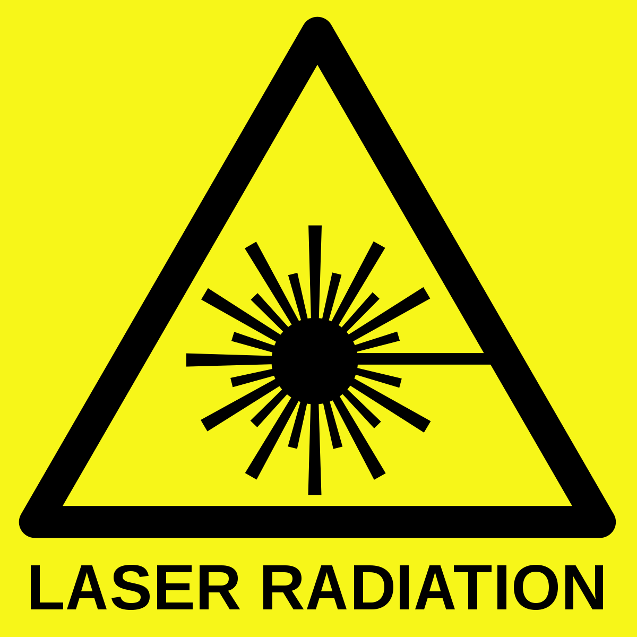
Infrared Laser Thermometer
Do not:
  Point lasers at your face
  Point lasers at other people
  Hold the thermometer close to heat lamps
Do:
  Take a reading of your own skin or a safe surface
  Hold the thermometer about a foot away from the sample

Slide 4
Explore Using IRT’s
Report

Slide 5
Infrared Camera Thermometer
Views Of Local Objects

Slide 6
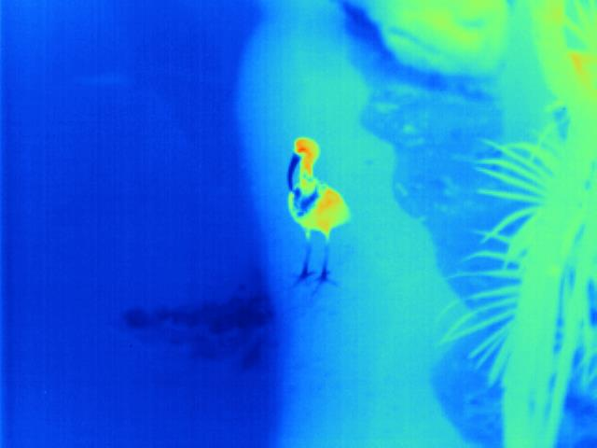
Notes:
In an infrared camera, temperatures are displayed for the entire picture. The warmer an object is, the more red it appears. The cooler it is, the more blue it appears.
Question? Based on the colors seen in this image, what do you think you are looking at?
Answer? An Ibis! In this picture you can see both the heat the bird puts out, but also areas that help dissipate heat or generally remain more cool (beak, chest feathers and legs).

Slide 7
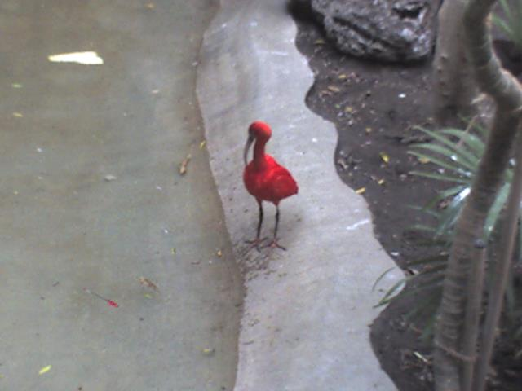
Notes:
Picture of an Ibis in normal light.

Slide 8
Notes:
A side-by-side view of both a visual camera and infrared camera view of an Ibis.

Slide 9
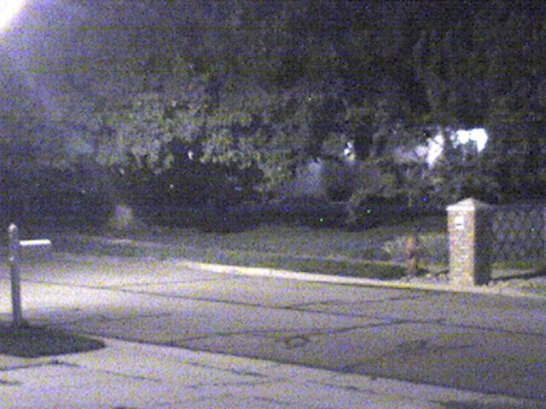

Slide 10
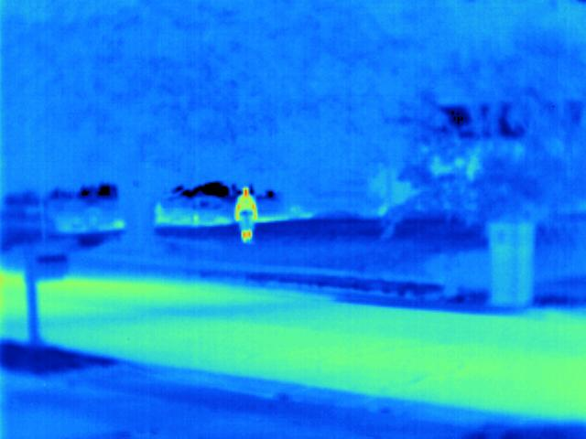

Slide 11
Notes:
What did you observe when comparing pictures taken with a heat camera versus a regular camera?
Scientists rely on observations and testing to answer questions they have about their ideas.

Slide 12
Notes:
What did you observe when comparing pictures taken with a heat camera versus a regular camera?
Scientists rely on observations and testing to answer questions they have about their ideas.

Slide 13
Infrared Camera Thermometer
View Of Salt Lake City

Slide 14
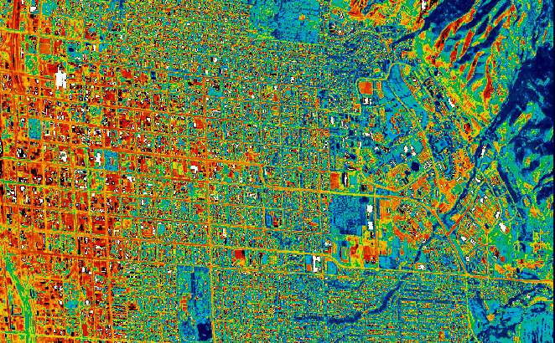
~ 85° F
~ 150° F
Notes:
The yellow and red areas are hot and generally correspond with roads and buildings; blue and green areas are cool and indicate water and vegetation. The white areas are about 71 deg. C (160 deg. F); blue and green areas are approximately 29-36 deg. C (85-96 deg. F).
How would the heat of an object/area effect the surrounding environment?
People become dehydrated/heat exhaustion
More power to run air conditioning/fans
Less rainwater absorbed into ground (more evaporates)
Touching hot surfaces hurts!
Absorbed heat radiates at night, making nighttime even warmer
As air heats up, it expands and becomes lower pressure. This lower pressure warm air rises, altering local wind patterns and cloud formation/precipitation.
How does this heated area affect people outside the downtown?

Slide 15
Mountains
Suburban Homes
Urban City
River
Park with grass and trees
~ 85° F
~ 150° F
Mostly Water and Vegetation
Mostly Roads and Buildings
Notes:
The yellow and red areas are hot and generally correspond with roads and buildings; blue and green areas are cool and indicate water and vegetation. The white areas are about 71 deg. C (160 deg. F); blue and green areas are approximately 29-36 deg. C (85-96 deg. F).
How would the heat of an object/area effect the surrounding environment?
People become dehydrated/heat exhaustion
More power to run air conditioning/fans
Less rainwater absorbed into ground (more evaporates)
Touching hot surfaces hurts!
Absorbed heat radiates at night, making nighttime even warmer
As air heats up, it expands and becomes lower pressure. This lower pressure warm air rises, altering local wind patterns and cloud formation/precipitation.
How does this heated area affect people outside the downtown?

Slide 16
Heat transfer activity

Slide 17
Make a prediction
Write one or two sentences below about whether you think your sample will heat at the same rate, slower, or faster than one being tested at another station and why:
Observation
Write one or two sentences about the difference between your prediction and observation (if any), why you think the result was what it was:
Impact
Write one or two sentences about where the material you observed can be found in every-day life and what impact it might have on the surrounding environment:

Slide 18
Measuring Heat Transfer
Proceed to your station.
Visually compare the sample you will be testing with one at another station.
Make your predictions and write them down.
Measure your sample’s starting temperature.
Wait for instructions on when to begin your measurements.
Record the temperature of your material every 60 seconds.
After taking your measurement at 10 minutes of heating, make sure your heat lamp is off and move the sample out from under the lamp.
Continue to record the temperature of your sample every 60 seconds.
After taking a final measurement at 10 minutes of cooling return to your seat and answer the question on your observations.

Slide 19
Infrared Laser Thermometer
Do not:
  Point lasers at your face
  Point lasers at other people
  Hold the thermometer close to heat lamps
Do:
  Take a reading of your own skin or a safe surface
  Hold the thermometer about a foot away from the sample

Slide 20
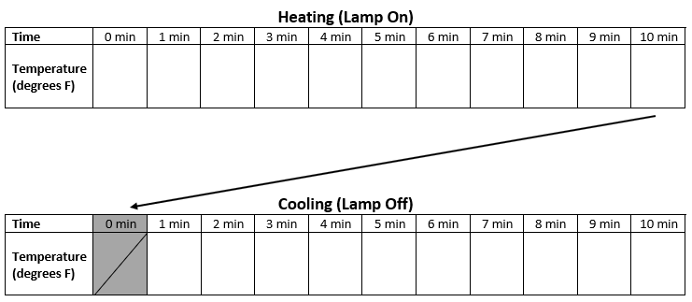

Slide 21
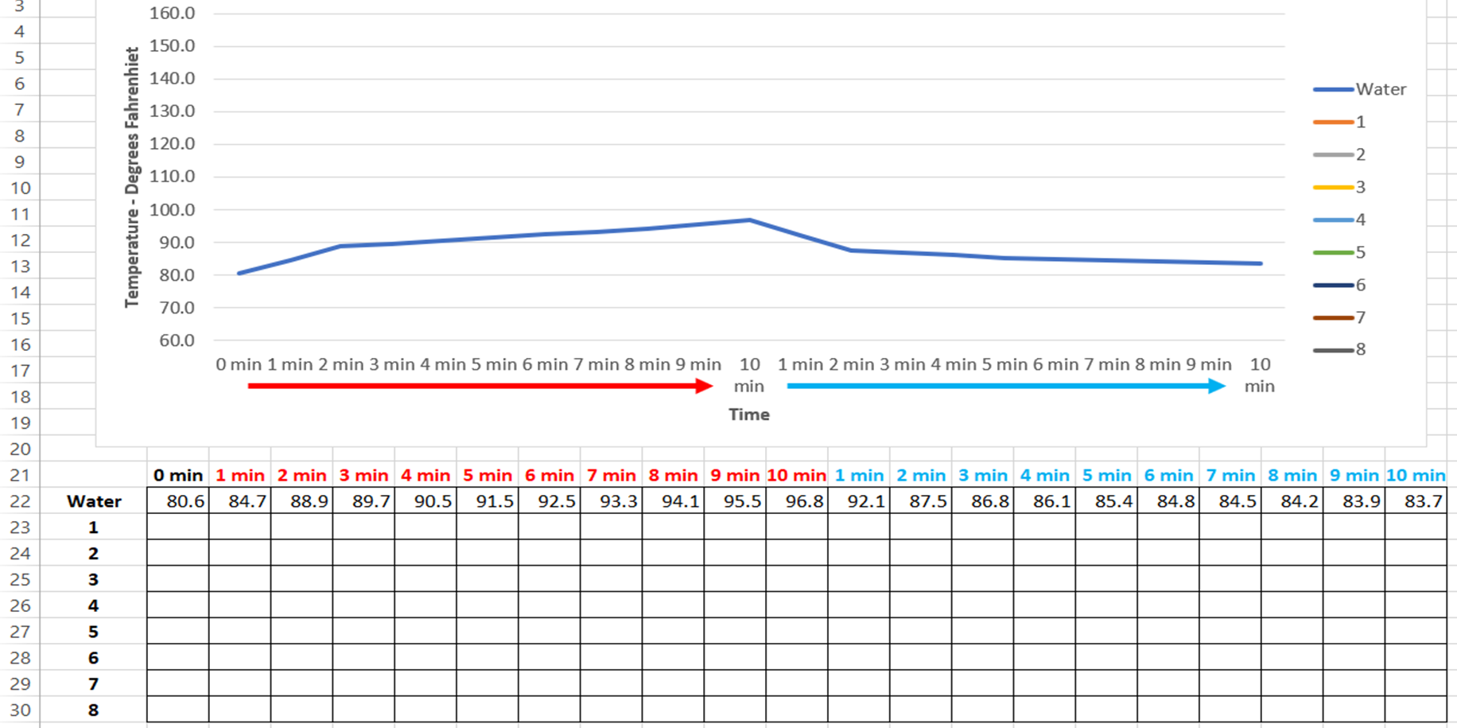

Slide 22
~ 85° F
~ 150° F
Mostly Water and Vegetation
Mostly Roads and Buildings
Notes:
The yellow and red areas are hot and generally correspond with roads and buildings; blue and green areas are cool and indicate water and vegetation. The white areas are about 71 deg. C (160 deg. F); blue and green areas are approximately 29-36 deg. C (85-96 deg. F).
How would the heat of an object/area effect the surrounding environment?
People become dehydrated/heat exhaustion
More power to run air conditioning/fans
Less rainwater absorbed into ground (more evaporates)
Touching hot surfaces hurts!
Absorbed heat radiates at night, making nighttime even warmer
As air heats up, it expands and becomes lower pressure. This lower pressure warm air rises, altering local wind patterns and cloud formation/precipitation.
How does this heated area affect people outside the downtown?

Slide 23
What Is Heat
and
How Is It Transferred?

Slide 24


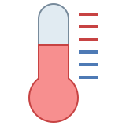
Heat
Temperature
Form of energy
Measurement of
hotness or coldness

Slide 25
 | Definition | Example on the Sun | Example on Earth
Convection | The transfer of heat by the movement of a fluid such as air | The swirling motion of plasma and gasses | Cooling yourself by using a fan
Conduction | The transfer of energy from a hotter object to a colder one when they come into direct contact with each other. |  | Losing heat from your house through the walls
Radiation | The transfer of energy in the form of electromagnetic waves | The way energy from the Sun moves through space | Cooking food in a solar oven or microwave

Slide 26
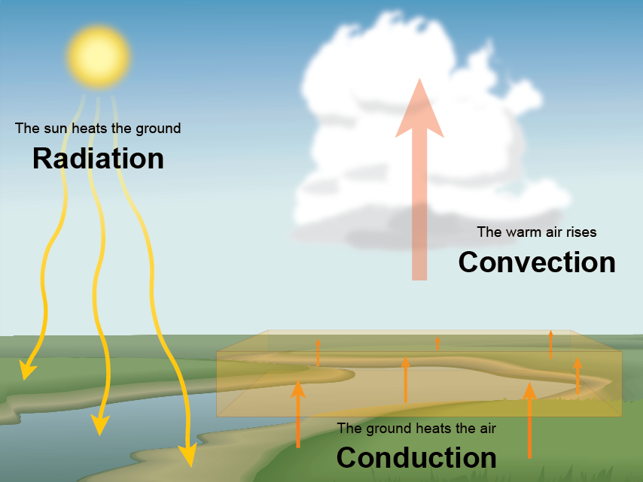

Slide 27
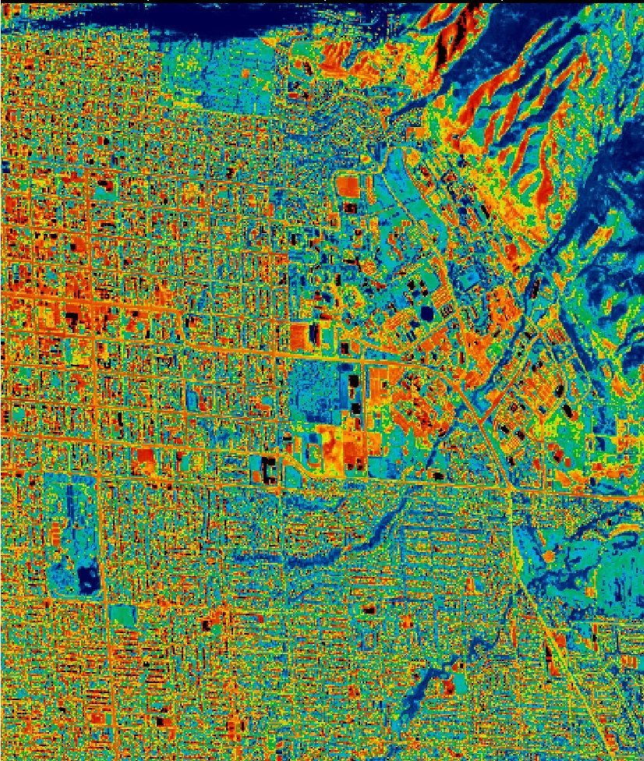
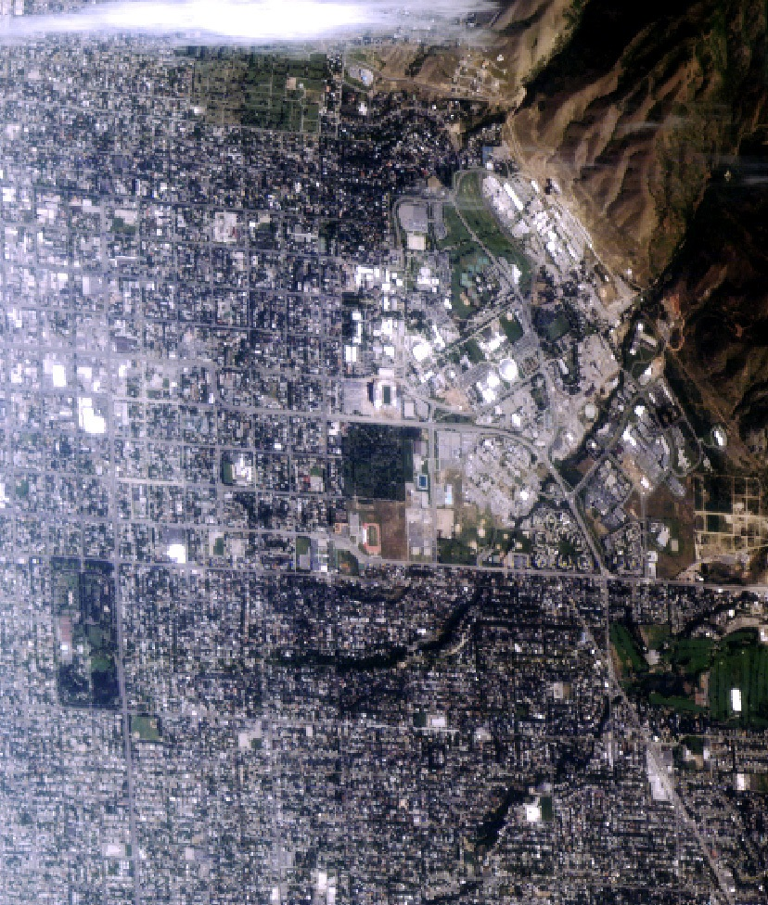
Hot / Less Dense Air
Cool / More Dense Air
Notes:
This is a normal view of Salt Lake City taken from a satellite.

Slide 28
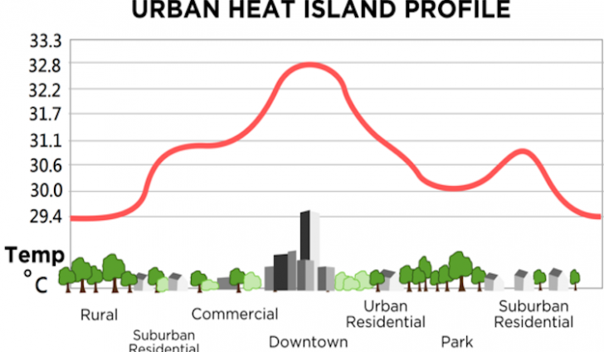
Hot / Less Dense Air
Cool / More Dense Air
Notes:
This is a normal view of Salt Lake City taken from a satellite.

Slide 29
Additional Slides And Info

Slide 30
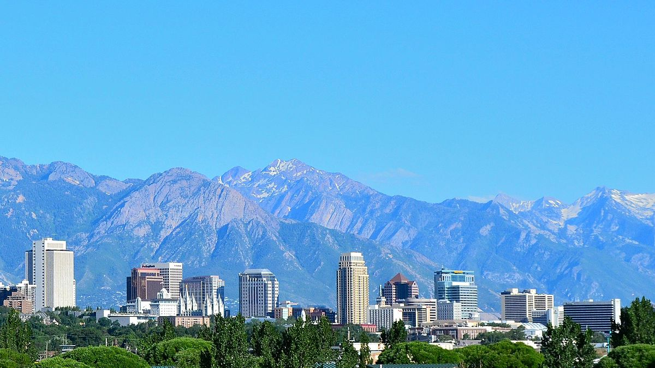

Urban Heat Island Effect
Heat flow to atmosphere
Heat flow to atmosphere
Heat flow to city air
Air Temperature
99 ° F
Heat flow to city air
Black Roof
177 ° F
White Roof
111 ° F
Heat flow into building
Heat flow into building

Slide 31
Surface | Details | Albedo
Soil | Dark and Wet Light and Dry | 5%- 40%
Sand |  | 15%-45%
Grass | Long Short | 16%- 26%
Agricultural Crops |  | 18%-25%
Tundra |  | 18%-25%
Forest | Deciduous Coniferous | 15%-20% 5%-15%
Water | Low Angle of Light High Angle of Light | 3%-10% 10%-100%
Snow | Old Fresh | 40%- 95%
Ice | Sea Glacier | 30%-45% 20%-40%
Clouds | Thick Thin | 60%-90% 30%-50%

Slide 32

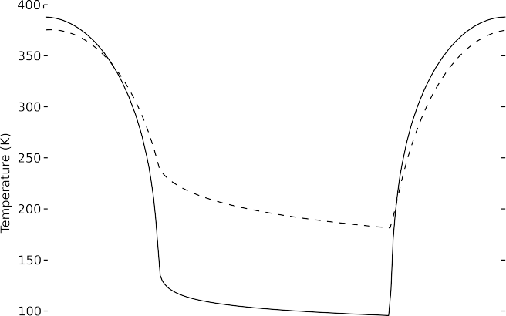

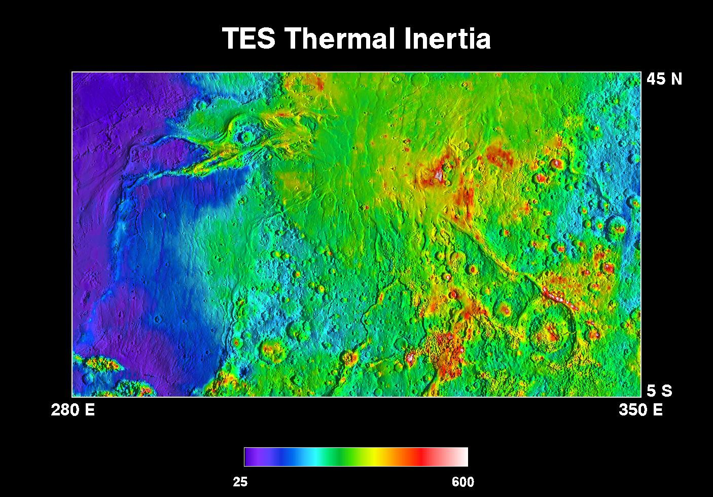
Background: Thermal Inertia
Thermal inertia (TI) is a physical parameter describing the tendency of a material to resist changes in temperature (formally: √kρc_{p})
rock
regolith
Dust and sand = low TI, rocks and densely packed grains = high TI
Orbital remote sensing highly successful for determining TI on Mars; used for geology and landing site selection

Slide 33
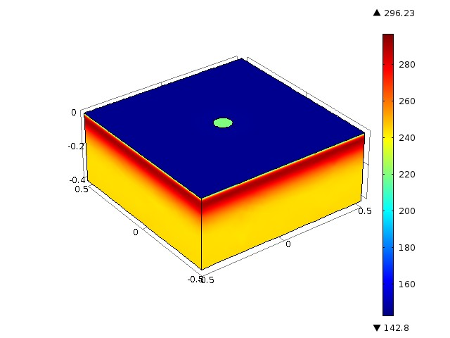
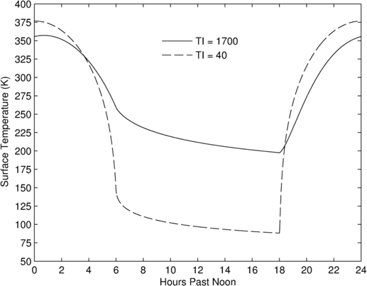



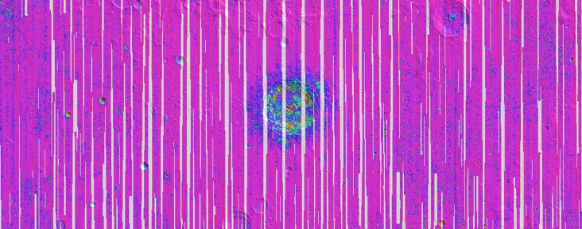
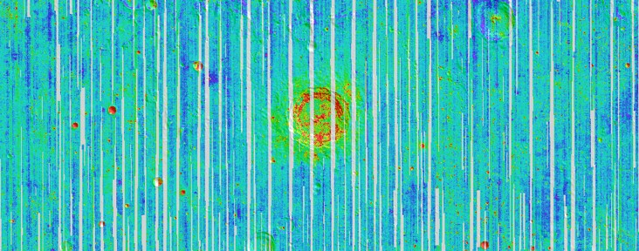
Rock Abundance & Regolith Temperature
Use Diviner nighttime brightness temperatures at different wavelengths to separate surface rocks from regolith
rock
rock
regolith
Two free parameters:
  Rock concentration
  Regolith temperature
0 3%
Rock abundance
colder cold
Regolith temperature
Bandﬁeld et al. (2011)

